Slide 1

PSET7: Ethics Video Presentation Team: Bethlehem B. Bethun B. Tousif S.

Slide 2
AGENDA
Group and Project Introduction
Executive Summary
Describe each Ethical Concern and Solution
Conclusion

Slide 3
Group and Project Introduction

Slide 4
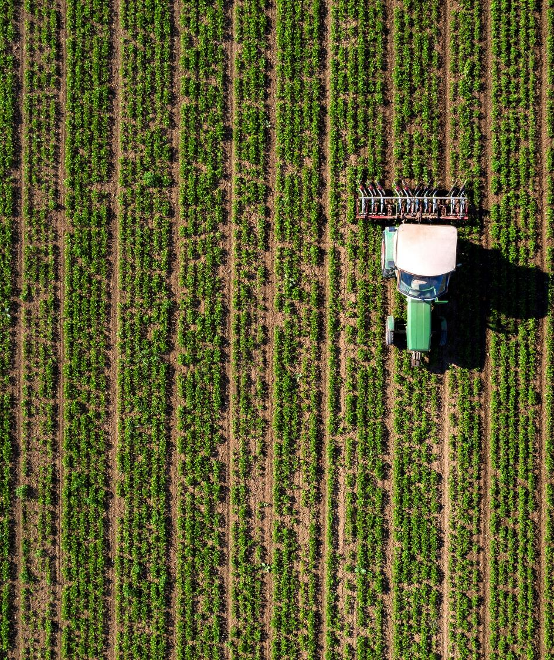
Project Name: Swarm Robotics ABM Simulation in Agriculture
Description:
We aim to build simulation algorithms of Swarm Robotics by leveraging ground robots and drones in an Agent-Based Model to improve yield optimization.
The algorithms will focus on:
efficiency and effectiveness in communication between the drones and ground robots
path planning, optimization, and coordination
weed detection and plant disease identification [Stretch Goal]
The project will explore scenarios with ground-only swarm robots and a combination of ground and aerial vehicles, using the Python MESA framework for agent-based modeling (ABM).

Slide 5
Executive SUmmary

Slide 6
Summary of Ethical Concerns
Environmental Impact
Data Privacy and Security
Job Displacement
Concern: While swarm robotics can reduce the environmental footprint of farming practices, manufacturing, operation, and disposal of these robots can cause environmental harm, since they're made of metals and plastics.
Concern: Swarm robotics systems will generate and utilize large amounts of data related to farm operations, crop health, and possibly even land and water use. There's a risk that this data could be misused, leading to privacy breaches or exploitation
Concern: The adoption of robotic swarms in agriculture might lead to significant job displacement, affecting farm workers whose livelihoods depend on manual labor in farming operations.

Slide 7
Describe each Ethical Concern and Solution

Slide 8
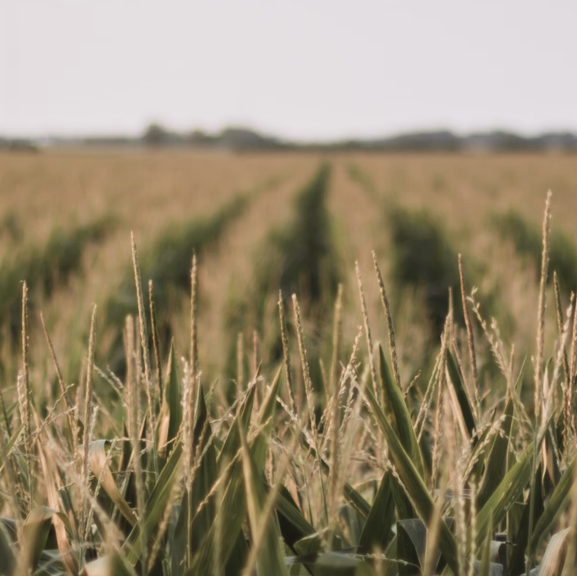
Environmental Impact
Concern:
Both ground robots and drones can disrupt wildlife nesting and foraging grounds, scare away pollinators, and trample vegetation.
Over-reliance on targeted herbicide application could lead to a decline in beneficial insect populations that naturally control pests.
Energy consumption of charging batteries or powering propulsion systems leads to carbon emissions and resource depletion.
Improper disposal of robot chassis can pollute landfills, soil, and water bodies.
Risk:
Risk associated with the environmental impact include soil disturbance, pollution, disruption of local ecosystems and potential chemical exposure.
Solution:
Alternating deployment areas and paths regularly with precise navigation and control systems to distribute the impact evenly across the field, allowing soil recovery. Also, optimizing energy use via routing algorithms to minimize idle time and unnecessary travel.
Impact:
Accidental spills, leaks, or drift during pesticide, herbicide, or fertilizer application can result in unwanted chemical exposure to the ecosystem and impact crop yield.
Movement patterns of robots could alter natural drainage patterns leading to waterlogging or erosion.

Slide 9

Data privacy and security
Concern:
Swarm robotics in agriculture relies processing vast amounts of data to optimize farming practices.
Data includes details about crop health, soil conditions, water usage, location, timings of farming activities.
Data increases efficiency and productivity, however, it also raises significant concerns regarding privacy and security.
Sensitive information could be accessed by unauthorized parties, leading to potential misuse.
Risk:
Risk associated with data privacy and security include cyber-attack and data breach leading to exposure of confidential information
Solution:
The data privacy and security concern can be addressed by implementing controls such as:
Encryption, Access control, Data Governance policies, Blockchain technology, Data Anonymization
Impact:
Loss of competitive advantage for farmers if proprietary farming techniques or data are leaked. Surveillance and the unauthorized tracking of activities within private properties.
Data breaches could hinder adoption and innovation in the sector.

Slide 10
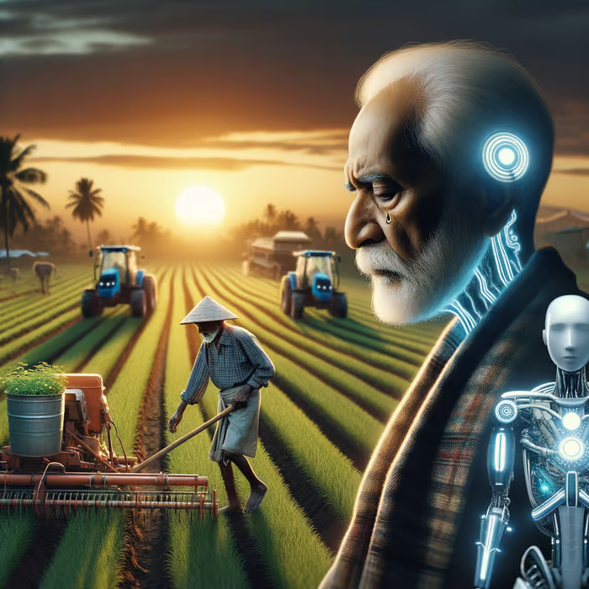
JOB DISPLACEMENT
Concern:
Swarm robotics could replace manual labor for farm workers reliant on various tasks involved in planting, monitoring and harvesting.
Job displacement can trigger poverty and reduced access to essential services
Small-scale farmers may face barriers to accessing and affording robotic swarm technology, exacerbating wealth inequalities
Decline in traditional farming practices and indigenous knowledge, risking loss of sustainable farming methods.
Risk:
Risk Associated with increase in unemployment and wealth inequality due to technology adoption and automation
Solution:
Investment in educating and upskilling farm workers
Policy and financial support for small-scale farmers to access swarm robot technology
Combine traditional knowledge with swarm robotics to improve profitability while preserving local knowledge and biodiversity
Impact:
Economic disruption and poverty for farmers
Weakened local economies due to migration in search of alternative employment
Barriers for small scale farmers operating on tight margins
Loss of traditional knowledge on resilience to local environments, promoting biodiversity, soil health, and water conservation.

Slide 11
Conclusion

Slide 12
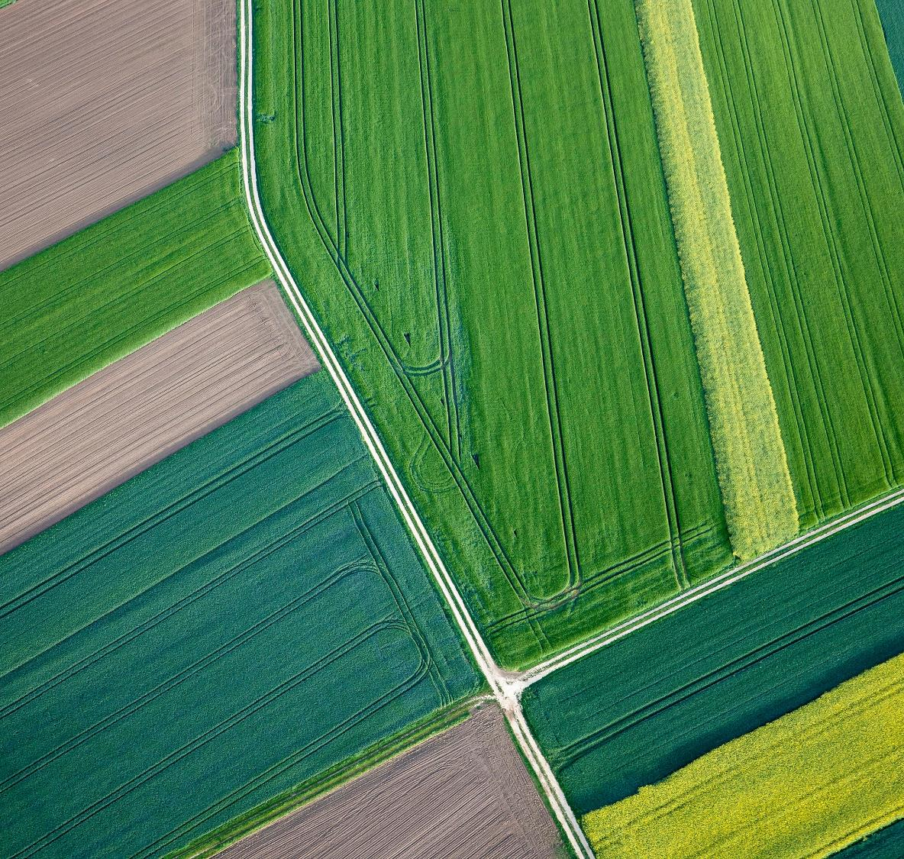
Conclusion
Environmental Impact: Addressing environmental ethical concerns in swarm robotics for agriculture requires minimizing disruption of wildlife, protecting soil health, designating flight zones, and promoting responsible herbicide use. Doing this ensure a productive and ecologically responsible agricultural future.
Data Privacy and Security: Addressing the ethical concern of data privacy and security in swarm robotics for agriculture involves implementing robust data governance and security measures to protect sensitive information, thus ensuring the sustainable and ethical advancement of this transformative technology.
Job Displacement: Addressing the ethical concern of job displacement in swarm robotics for agriculture involves upskilling farm workers, policy and financial support for small-scale farmers, and combining traditional knowledge with swarm robotics to improve profitability while preserving local knowledge and biodiversity

Slide 13
REferences

Slide 14
References
https://www.frontiersin.org/articles/10.3389/fsufs.2022.903230/full
https://acsess.onlinelibrary.wiley.com/doi/full/10.1002/agj2.20968
https://www.frontiersin.org/articles/10.3389/fsufs.2022.884187/full
https://www.researchgate.net/publication/362260169_Big_Data_Privacy_in_Smart_Farming_A_Review
https://www.frontiersin.org/articles/10.3389/fsufs.2022.903230/full
https://dspace.lib.cranfield.ac.uk/bitstream/handle/1826/19331/agricultural_robotics-2023.pdf?sequence=1&isAllowed=y#:~:text=Concerns%20also%20include%20precision%20technologies,to%20adapt%20to%20new%20conditions%20
https://link.springer.com/article/10.1007/s00146-021-01377-9
https://library.oapen.org/bitstream/handle/20.500.12657/61554/1/9781801463577.pdf
https://www.linkedin.com/pulse/ethics-ai-agritech-balancing-innovation-tanveer-inamdar--r7cyf/
https://www.ncbi.nlm.nih.gov/pmc/articles/PMC9372537/
https://researchmgt.monash.edu/ws/portalfiles/portal/342553024/324307954_oa.pdf
https://aiforgood.itu.int/agricultural-robots-farming-smarter-not-harder/
https://www.sustainability-times.com/sustainable-business/farm-robots-could-help-save-the-environment-or-further-destroy-it/

Slide 15
THANK YOU
Team: Bethlehem B. Bethun B. Tousif S.

